Slide 1
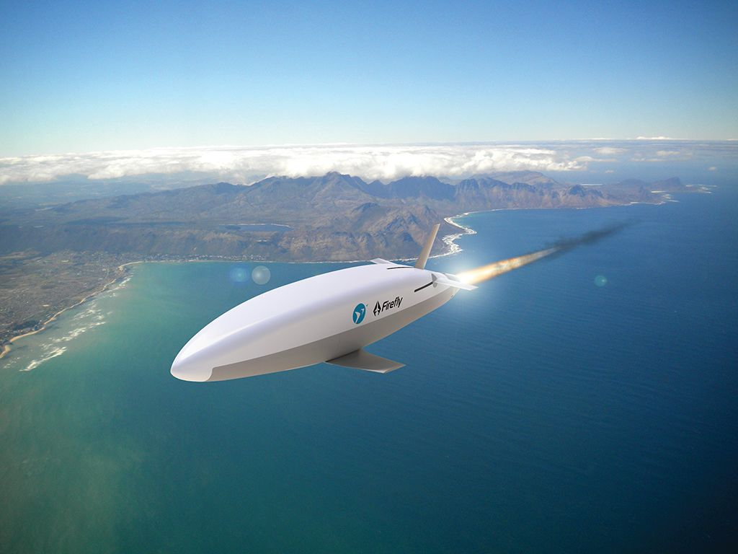
A Differentiable Framework for Aircraft Design Optimization
Peter Sharpe MIT Aeronautics and Astronautics
March 22, 2021

Slide 2
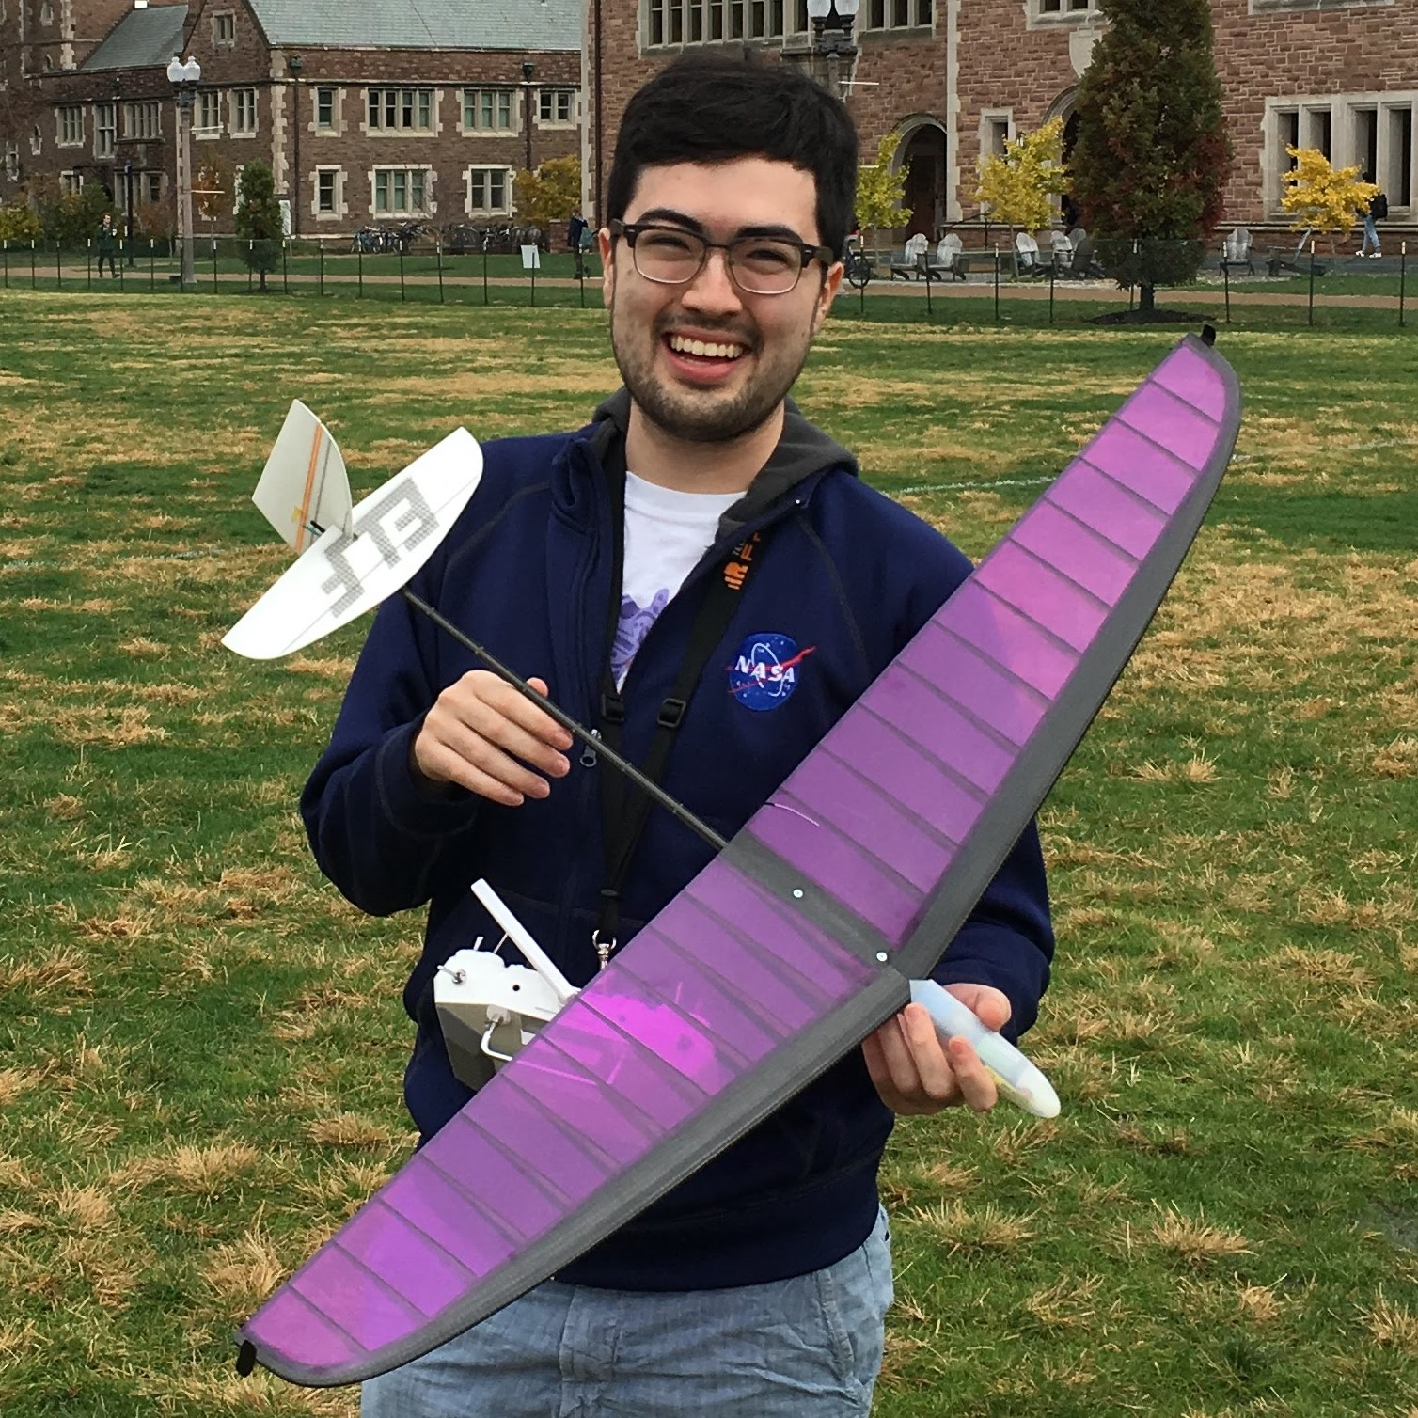
About Me
2nd year graduate student at MIT Int’l Cntr. for Air Transportation (Prof. John Hansman)
Research focuses:
Aircraft Design
Multidisciplinary Design Optimization (MDO)
Computational Aerodynamics
These are all really the same thing!*
*or can be reduced to the same thing
Notes:
Secret of this talk: these are all really the same thing!
Hope you’ll appreciate that a bit more by the end of this talk.
Start with aircraft design, which motivates all this.

Slide 3
Outline
01
Motivations and challenges for aircraft design optimization (10 min.)
02
AeroSandbox: a new design framework (20 min.)
03
Applications and case studies (20 min.)
Notes:
Brief outline:
Read
Firefly
Let’s start with the first word: optimization.

Slide 4
Aircraft Design Optimization
Motivations and Challenges

Slide 5
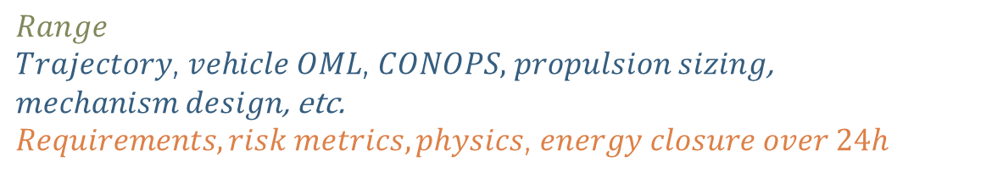
Motivations: Why Optimization?
Optimization is one of the mathematical problems using up the most CPU cycles around the world at this second.
Engineering design is fundamentally an optimization problem.
Sometimes formalized, sometimes not
Four key parts:
Objective function: The metric you are minimizing
Variables: The “knobs” that you have to work with
Sets the dimensionality of the design space
Constraints: Your requirements
Limits the design space to a feasible space
Equality constraints are a projection (dimensionality reduction)
Can be active or inactive
Parameters: Your assumptions
Problem formulation is by far the most important step of design optimization
Maximize:
With respect to:
Subject to:
$$Range$$
$Trajectory$, $vehicle OML$, $CONOPS,$ $propulsion sizing$, $mechanism design$, etc. $Requirements, risk metrics, physics$, $energy closure over 24h$
Firefly
Notes:
What do we mean when we say optimization:
Making the best decision under some assumptions and models of the world
Optimization:
- one of the mathematical problems using up the most CPU cycles around the world at this second.
- Underlies everything from Google Maps to economic decisions to aircraft design
- Math PhD student: “Optimization” is the practice of turning math theorems into money.
Constraints:
Constraints tend to be the most interesting part of a design optimization problem
Active, tight, driving -> synonyms
Inactive constraint:
The wing spar must fit inside the airfoil
Wing spar is gauge-limited due to buckling considerations, doesn’t hit this constraint
If constraints aren’t active, you likely don’t need to spend much time refining that constraint
Be sure to spend a lot of time figuring out what the right question to ask is
* The same problem with two different formulations (change of variables, transformation of design space, etc.) can take orders of magnitude more time to solve*

Slide 6
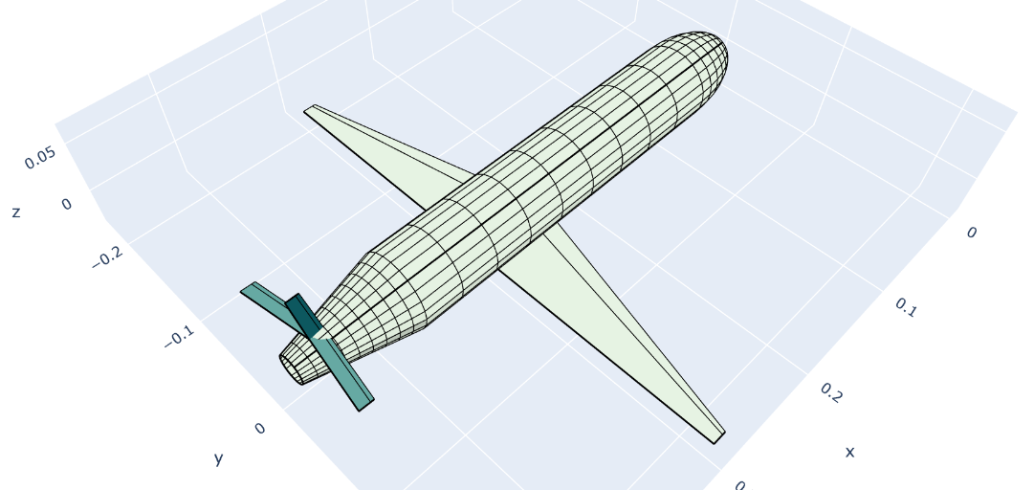
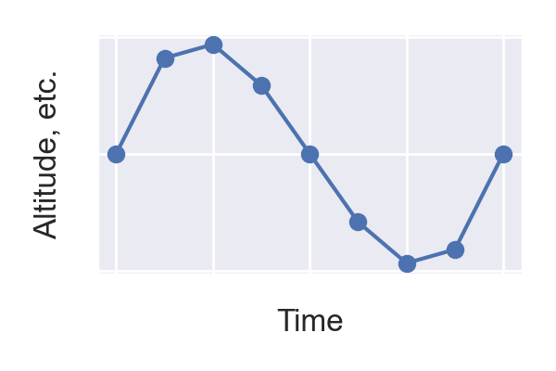
Example: The Firefly Design Problem
Simultaneously optimizing...
Mission Profile (simulation/control)
Aircraft Design
Design Variables
Hundreds, including:
wing, stabilizer, fuselage geom.
nozzle dimensions
propellant mass and chemistry
insulation thickness
Parameters
canister dimensions
payload dimensions
overall configuration
Operational Variables
Thousands, including:
altitude
airspeed
oxamide distribution
ctrl. surf. inputs
Parameters
altitude constraints
speed requirements
propulsion requirements & margins (e.g. no flame-out)
Objective Function
Maximize total range
Constraints
Physics models
~150 models, 9,000 constraints
Notes:
Two key case studies that we’ll talk about today
I’ve chosen them because they’re at opposite “corners” of the aircraft design space
Firefly: Mach 0.8 rocket-propelled micro-UAV
Matters not only what you fly, but also how you fly
Especially in the case of a solid rocket propellant, your thrust profile is “baked in” to the design
Firefly rides the critical mach line
Any misstep in trajectory, overspeed -> strong shock waves, all that excess energy is burned off as wave drag
If you look at energy loss as a function of “excess mach”, it’s locally “excess mach” to the 5th power
You really hit a wall

Slide 7
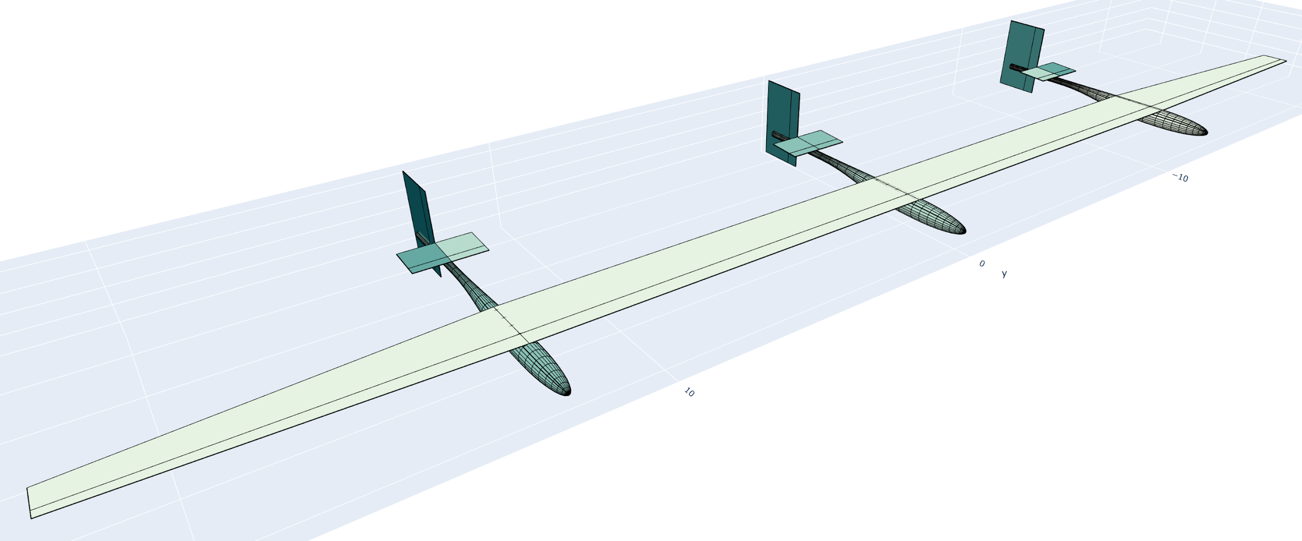
Example: The Solar Airplane Design Problem
Simultaneously optimizing...
Mission Profile (simulation/control)
Aircraft Design
Design Variables
Hundreds, including:
wing geom. (two-sect.),
tail geom. (one-sect.),
boom geom.,
propeller params.,
battery cap.,
solar panel area,
motor rated power,
wing internal struct.
Parameters
payload mass
# of booms
battery spec. energy
margins
Operational Variables
Thousands, including:
altitude
airspeed
throttle
ctrl. surf. inputs
Parameters
min. altitude
wind speed dist.
latitude
day of year
Objective Function
Minimize wingspan
Constraints
Physics models
~150 models, ~4,000 constraints
Notes:
Both:
What you fly
Fairly obvious that this matters
How you fly
A little less obvious
Particularly over the course of a 24h period
Altitude cycling
Use altitude as a battery
Ascend during day, descend during evening
For some missions, this isn’t significant; for others, it will be very significant
Different airspeeds at day and night
Can anyone think of roughly the best V-speeds to fly at during day and night?
Day:
Roughly best climb speed
Night:
Minimum sink speed

Slide 8
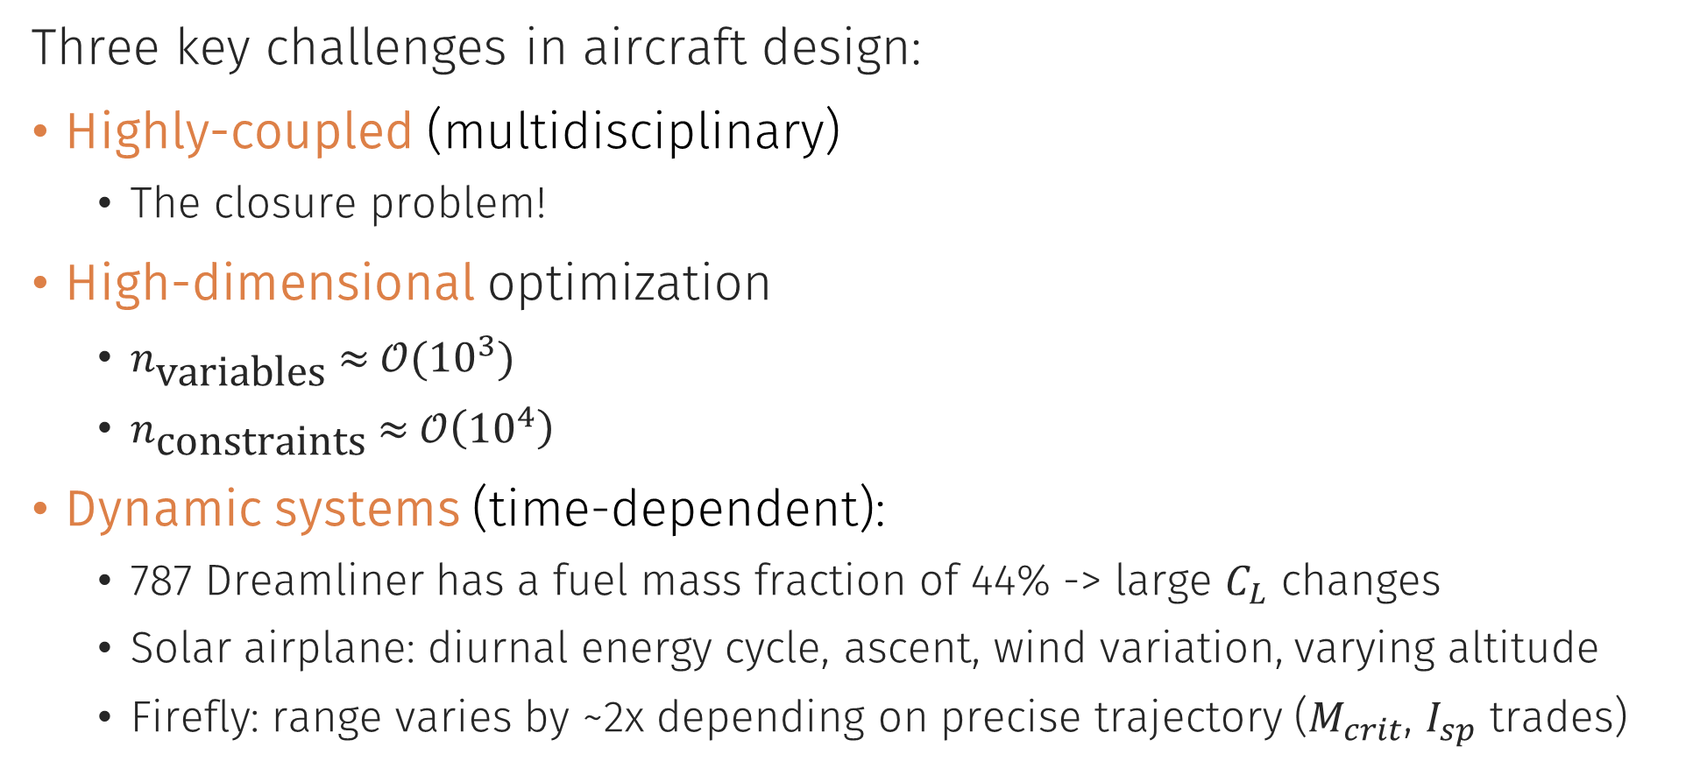
Optimization Challenges
Three key challenges in aircraft design:
Highly-coupled (multidisciplinary)
The closure problem!
High-dimensional optimization
$n_{\text{variables}} \text{≈} 𝒪({10}^{3})$
$n_{\text{constraints}} \text{≈ }𝒪\left({10}^{4}\right)$
Dynamic systems (time-dependent):
787 Dreamliner has a fuel mass fraction of 44% -> large $C_{L}$ changes
Solar airplane: diurnal energy cycle, ascent, wind variation, varying altitude
Firefly: range varies by ~2x depending on precise trajectory ($M_{crit}$, $I_{sp}$ trades)
Typical Disciplines
Aerodynamics
Structures
Propulsion
Stability & Control
Trajectory/Dynamics
Mission-specific requirements
…
Weights
Power Systems
Notes:
Time dependence
This solar airplane problem is inherently unsteady
Day/Night energy injections into system
Differing power requirements during day/night
Science value and wind fluctuations over day
Ascent as a sizing case
Nearly all aircraft design problems are unsteady in some sense
787 Dreamliner has a fuel mass fraction of 44%
Briefly going to talk about key challenges in aerospace design optimization:
Just surface level
Goal is to illustrate what kinds of problems are tractable, and what kinds of problems aren’t

Slide 9
Addressing Coupled Problems
The Closure Problem
Internal closure loop! (Implicit)
Guess and check?
Aerodynamics
Scales very poorly…
Power Systems
Structures
Driving dependencies (just to 1st order!)
We need to implicitly solve for all disciplines in one shot!
Weights
Geometry
Propulsion
Trajectory / Dynamics
Stability & Control
Some even go both ways!
Notes:
Internal closure loop:
If we wanted to optimize some metric of the system:
Not only would we have to iterate to optimize
We would also have to do “sub-iterations” to close loops
“for loop in a for loop” - slow

Slide 10
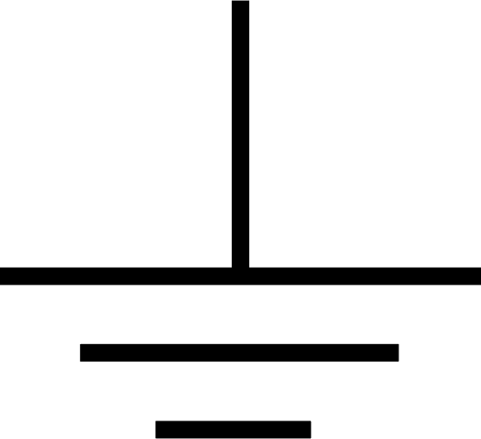
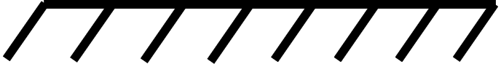
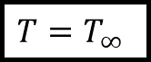
Why are Aerospace Problems so Coupled?
Typical engineering systems:
On free-flying aerospace systems:
Nowhere to dump conserved quantities:
Mass
Momentum
Energy
Heat
Charge
etc.
Each force and moment must be perfectly balanced with all others
All subsystems must be designed at the same time
$$T=T_{∞}$$
Notes:
Coupling is not unique to aerospace design, but I’m gonna make the claim that it’s far more of a problem in aerospace than in other engineering applications.
Nowhere to dump conserved quantities (momentum, energy, heat, charge, etc.) on an airplane
If you’re designing a cantilever beam, there’s a fixed support
If you’re designing a circuit, there’s a ground
If you’re designing an engine, there’s some place for heat rejection
Aerospace systems have nothing to “push off of”
Each force and moment must be perfectly balanced with another

Slide 11
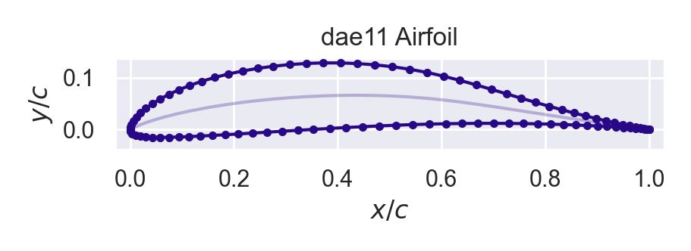
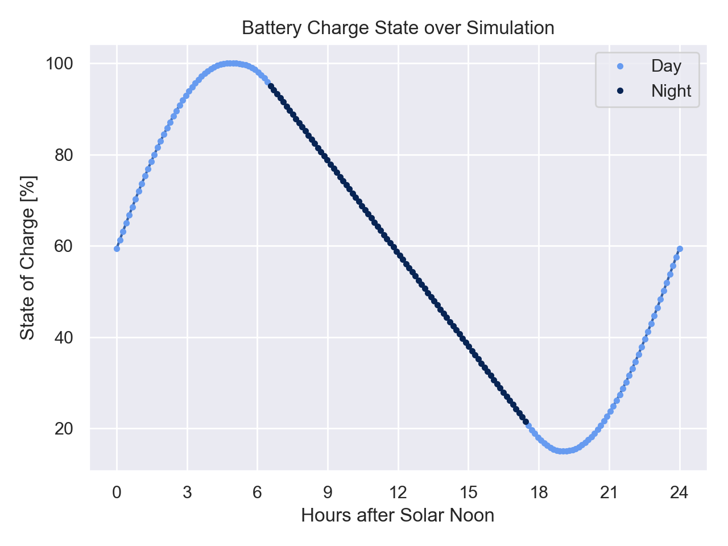
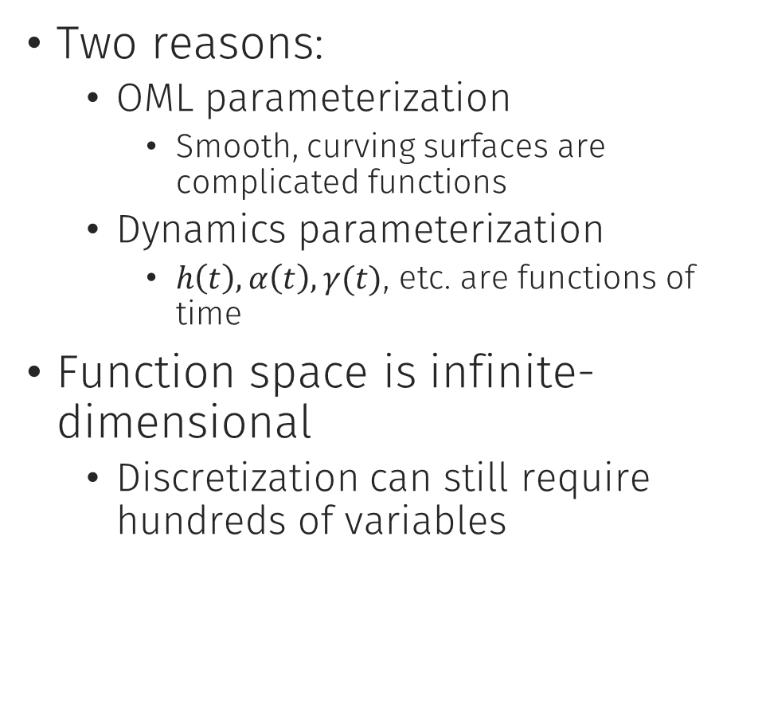
Why are Aerospace Problems so High-Dimensional?
Two reasons:
OML parameterization
Smooth, curving surfaces are complicated functions
Dynamics parameterization
$h\left(t\right), α\left(t\right), γ(t)$, etc. are functions of time
Function space is infinite-dimensional
Discretization can still require hundreds of variables

Slide 12
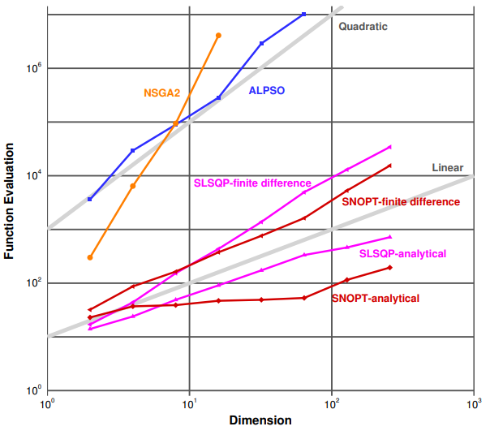
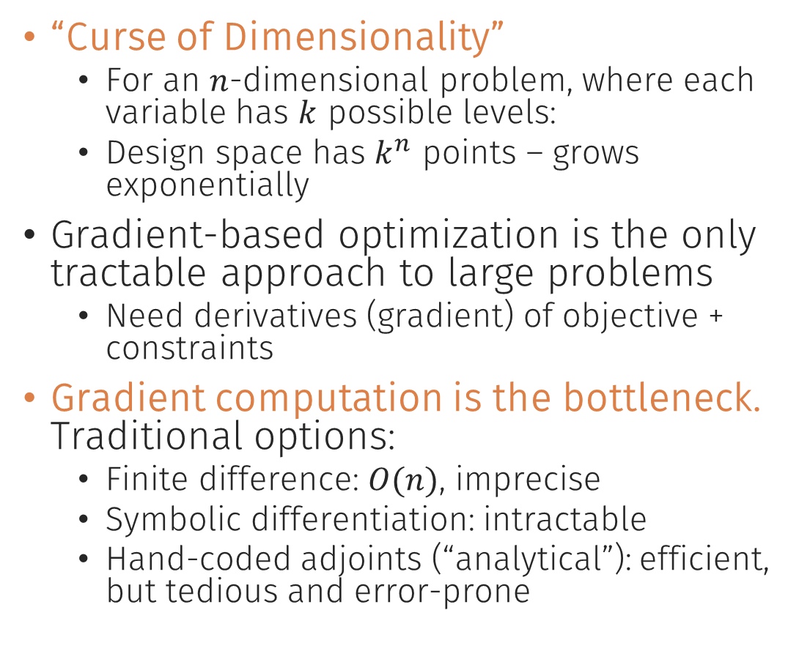
High-Dimensional Optimization
“Curse of Dimensionality”
For an $n$-dimensional problem, where each variable has $k$ possible levels:
Design space has $k^{n}$ points – grows exponentially
Gradient-based optimization is the only tractable approach to large problems
Need derivatives (gradient) of objective + constraints
Gradient computation is the bottleneck. Traditional options:
Finite difference: $O(n)$, imprecise
Symbolic differentiation: intractable
Hand-coded adjoints (“analytical”): efficient, but tedious and error-prone
Dimensionality vs. Computational Cost
Figure reproduced from J. Martins, 2013 pres., “A Very Short Course on Multidisciplinary Design Optimization”
Notes:
Curse of Dimensionality
Imagine an n-dimensional problem, and assume each variable has three settings – low, med, high.
The number of possible designs grows like 3^n – it runs away from us extremely quickly
Clearly sweeping whole the space is out of the question.
Gradient-based
It turns out that gradient-based optimization is really the only tractable approach here
Second-order
So we look at both the Jacobian and Hessian
Automatic differentiation
On chart: analytical derivatives (similar to automatic differentiation) scale sublinearly with dimensionality
With efficient derivatives, you can actually solve n-dimensional optimization problems in fewer than n function evaluations
Something interesting to think about
“Automatic” part vs. analytical derivatives
You don’t have to think about these derivatives
It all happens under the hood
Kind of a theme here: we’re trying to abstract away all the optimization numerics so that you can focus on:
Asking the right questions
(equally importantly) Writing the right physics models

Slide 13
AeroSandbox
A Differentiable Aircraft Design Framework

Slide 14

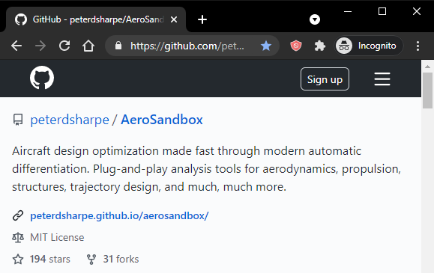
AeroSandbox Overview
Key features:
An optimization framework for engineered systems
Contains hundreds of mutually-compatible differentiable aerospace models
Surrogate modeling tools to make new differentiable models from user data (e.g. CFD, flight test)
Object-oriented aircraft geometry framework and performance stack
Notes:
Targets these challenges:
Highly coupled problems
Very high dimensionality
Time-dependent

Slide 15
AeroSandbox Overview
Code details:
Python 3
Cross-platform
Open-source (MIT license), GitHub-hosted
A rapidly growing ecosystem:
18 months old, originally created to support the BAE-sponsored Firefly program
126k downloads, 17k in past month
3 student developers, many other internal MIT contributors
19 external contributions to-date from various universities, companies
Notes:
18 months: 126k downloads, 17k in past month: growth is fairly exponential
Design programs:
Basis for:
MIT:
Firefly
Dawn
SSTOL
Rocket re-entry
Student design teams
Outside MIT:
AIAA papers from several universities
At least one homebuilt airplane

Slide 16

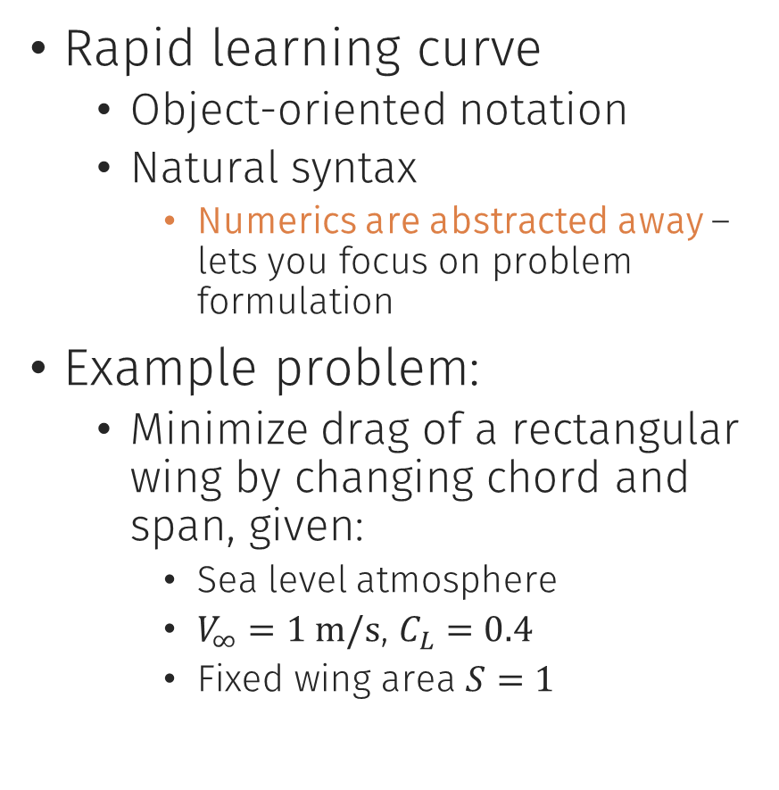
“Opti” Optimization Stack
Rapid learning curve
Object-oriented notation
Natural syntax
Numerics are abstracted away – lets you focus on problem formulation
Example problem:
Minimize drag of a rectangular wing by changing chord and span, given:
Sea level atmosphere
$V_{∞}=1 \text{m}\text{/}\text{s}$, $C_{L}=0.4$
Fixed wing area $S=1$
opti = asb.Opti() chord = opti.variable(init_guess=1) span = opti.variable(init_guess=1) Re = velocity * chord / kinematic_viscosity CD_p = 1.328 * Re ** -0.5 AR = span / chord CD_i = CL ** 2 / (pi * AR) opti.subject_to(chord * span == 1) opti.minimize(CD_p + CD_i) sol = opti.solve() print(sol.value(chord), sol.value(span))
Make an optimization problem
Make design variables and set initial guesses
Model profile drag*
Model induced drag
Constrain the wing area
Set an objective function
Solve
Show results
Imports/constants above
Result: $c=0.229$ m, $b=4.37$ m

Slide 17
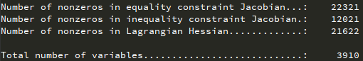

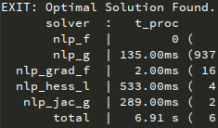
“Opti” Optimization Stack
Opti is fast – really, really fast.
Speed enables “interactive design”
“Secret sauce”:
Automatic differentiation (AD) everywhere
Simultaneous Analysis and Design (SAND) architecture
Sparsity exploitation
Up next:
Under the hood
Solutions enabled
Example Problem:
Firefly design optimization
8 disciplines
3910 variables
8420 constraints
34321 constraint-variable interactions
Nonlinear, nonconvex
6.91 seconds to solve on a laptop.

Slide 18
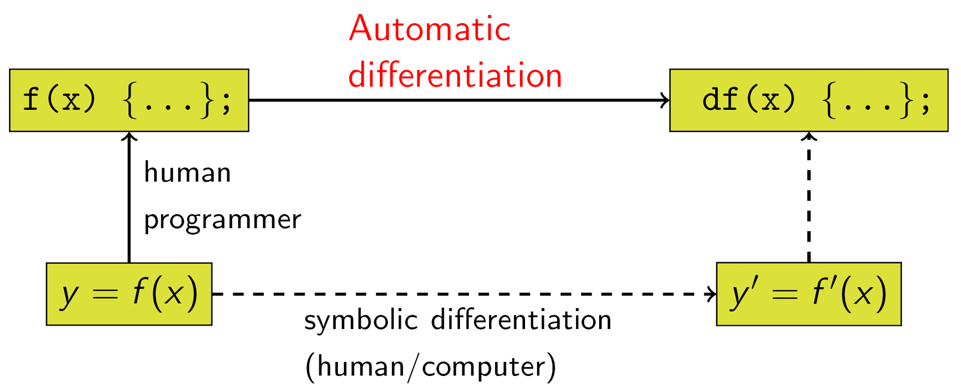
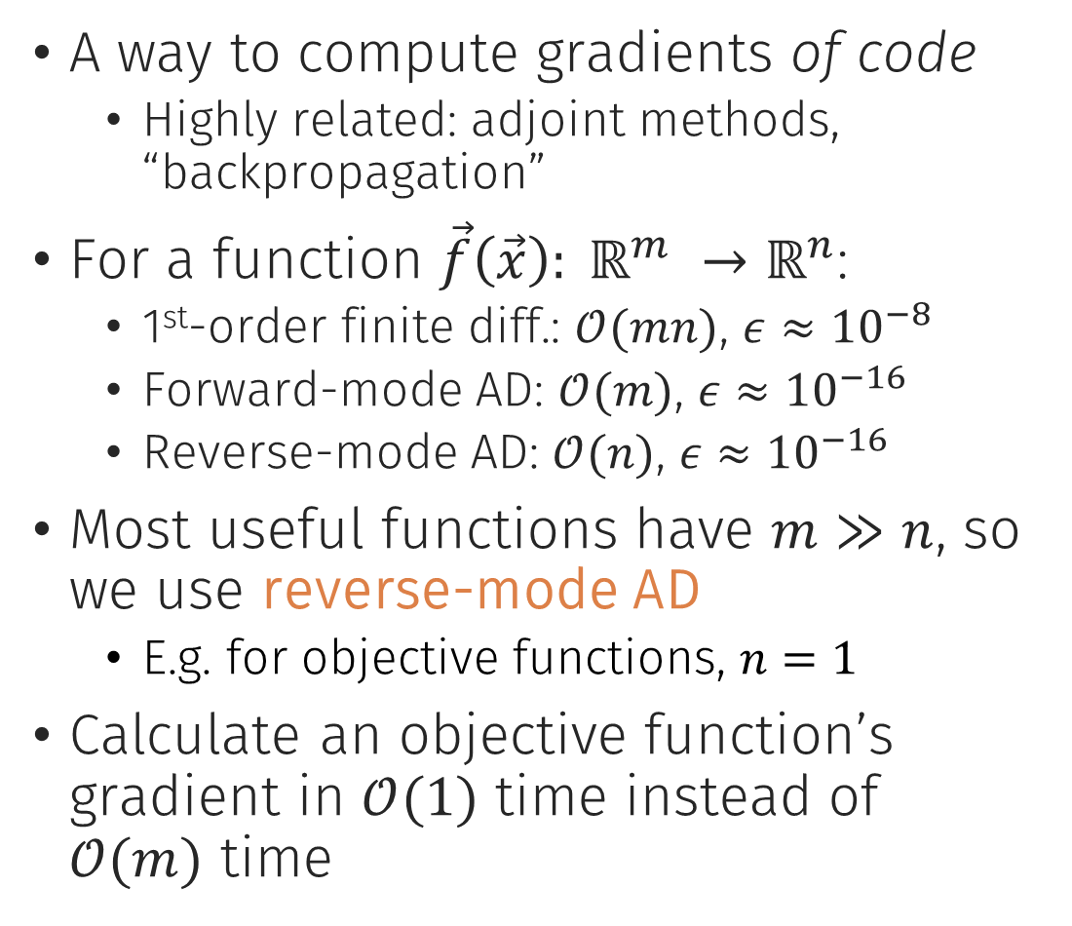


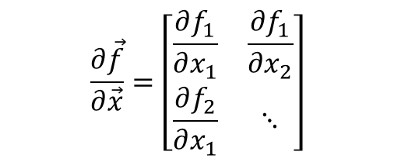
Automatic Differentiation (AD)
A way to compute gradients of code
Highly related: adjoint methods, “backpropagation”
For a function $\vec{f}\left(\vec{x}\right): ℝ^{m} →ℝ^{n}$:
1st-order finite diff.: $𝒪(mn)$, $ε≈{10}^{−8}$
Forward-mode AD: $𝒪(m)$, $ε≈{10}^{−16}$
Reverse-mode AD: $𝒪(n)$, $ε≈{10}^{−16}$
Most useful functions have $m≫n$, so we use reverse-mode AD
E.g. for objective functions, $n=1$
Calculate an objective function’s gradient in $𝒪(1)$ time instead of $𝒪(m)$ time
$$m$$
$$\frac{∂\vec{f}}{∂\vec{x}}=\left[\begin{matrix}\frac{∂f_{1}}{∂x_{1}} & \frac{∂f_{1}}{∂x_{2}} \\ \frac{∂f_{2}}{∂x_{1}} & ⋱\end{matrix}\right]$$
$$n$$
Relationship between automatic and symbolic differentiation (Source: Wikimedia)
Notes:
AD in Neural Networks:
Neural networks: invented in the 1940s, explored extensively in the 70s
Abandoned until ~2010, when someone figured out how to do AD on GPUs
AD in optimal control:
Trajectory optimization, model predictive control
Boston Dynamics robots, SpaceX landings – both using flavors of AD (though a different kind of optimization)
For a function:
Accuracy figures assuming:
double precision floating point arithmetic
nonlinear functions with normalized curvature
best possible step size for finite-difference
If people are more curious, I have some extra charts with a simple AD example – we’ll skip for time, but happy to talk through at the end

Slide 19
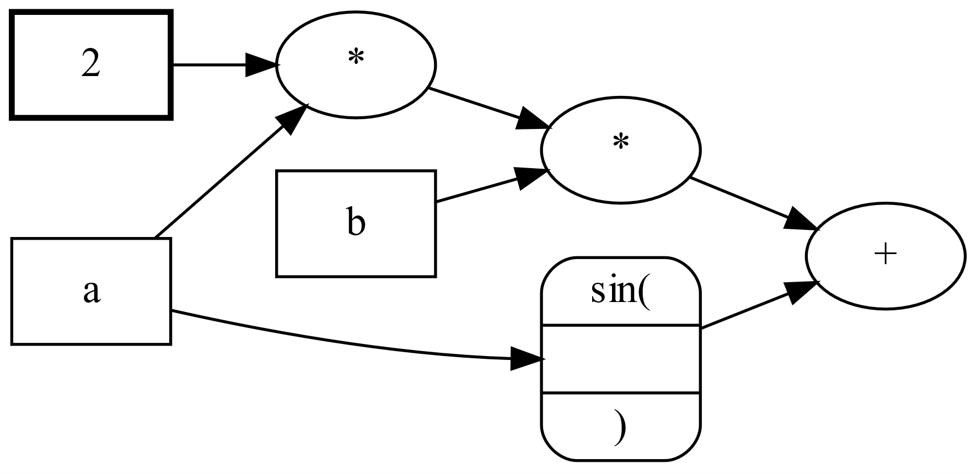


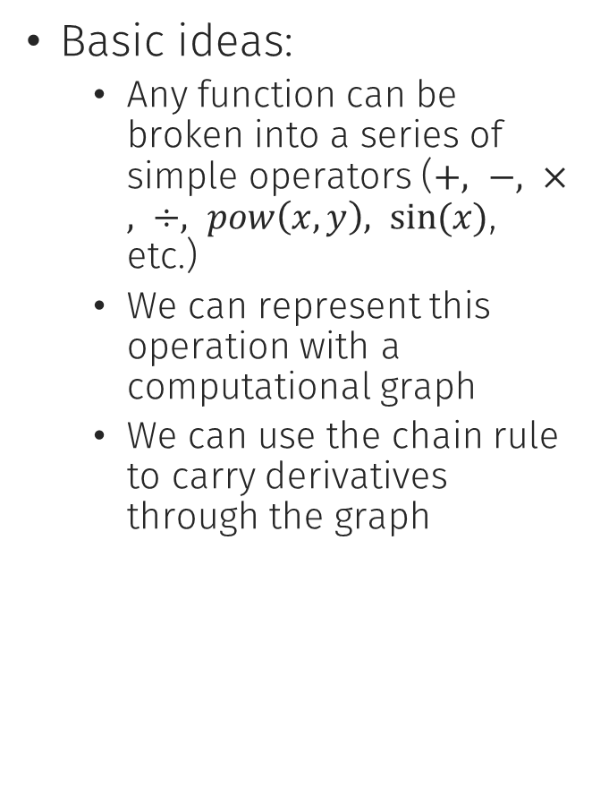
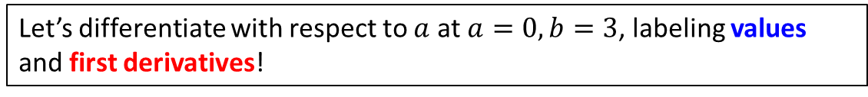





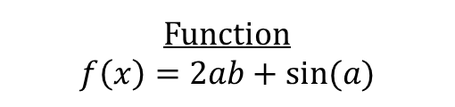

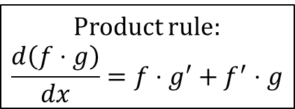
Automatic Differentiation (AD)
Basic ideas:
Any function can be broken into a series of simple operators ($+, −, ×, ÷, pow\left(x,y\right), sin⁡(x)$, etc.)
We can represent this operation with a computational graph
We can use the chain rule to carry derivatives through the graph
Function
$$f\left(x\right)=2ab+sin⁡(a)$$
Computational Graph
Product rule:
$$\frac{d\left(f⋅g\right)}{dx}=f⋅g^{′}+f^{′}⋅g$$
$$2$$
$$0$$
$$0$$
$$2$$
$$0$$
$$6$$
$$3$$
$$0$$
$$0$$
$$7$$
$$0$$
$$1$$
$$0,1$$
Two flavors of AD
Forward mode
Cost scales with # of inputs
Reverse mode
Cost scales with # of outputs
Let’s differentiate with respect to $a$ at $a=0, b=3$, labeling values and first derivatives!

Slide 20
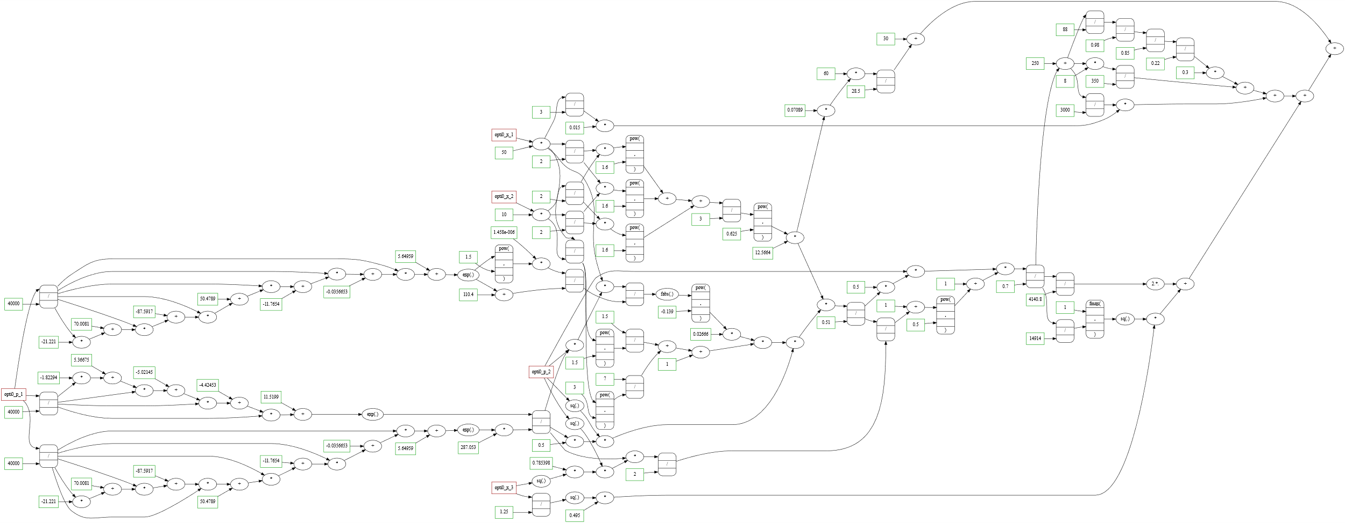
Automatic Differentiation (AD)
You can make a differentiable graph for any function!
Computational graph of mass calculation for a solar-powered blimp
Notes:
Might not need to convince them of this, backup?
Show firefly, show the WHOLE graph (then blow it up)

Slide 21
Simultaneous Analysis and Design (SAND)
Nonlinear Optimization General form:
$$\text{minimize} 0$$ $\text{by} \text{changing} \vec{x}$, $$\text{subject} \text{to}: \\ f\left(\vec{x}\right)=\vec{0}$$
Nonlinear Optimization General form:
"minimize " 0 "by changing" 𝑥 ⃗, "subject to": 𝑓(𝑥 ⃗ )=0 ⃗
Nonlinear Sys. of Eqns. General form:
$$\text{Find} \vec{x}, given: \\ \vec{f}(\vec{x})=\vec{0}$$
Nonlinear Sys. of Eqns. General form:
"Find" 𝑥 ⃗, given: 𝑓 ⃗(𝑥 ⃗)=0 ⃗
Analysis: solving systems of nonlinear equations
ODEs, PDEs can be discretized
Internal closure loops can be constructed as residuals
How to optimize:
Traditional: wrap analysis in an optimizer (nested)
SAND: embed analysis into optimization as constraints
Solve governing eqns. and optimality simultaneously
Eliminates internal closure loops
Constraining residuals
Dual variables
* Exploiting this duality for engineering design was pioneered by Raphael Haftka in the 1980s
Notes:
Okay, so AD solves the “dimensionality” problem, but how do we solve the “coupled analysis” problem?
What is analysis? All engineering analysis can be reduced to solving a system of governing equations (often, nonlinear)
SAND: solve governing equations and optimality simultaneously
Let’s say you’re optimizing a system, and it takes 100 iterations
Early iterations: far from optimal design
Solving governing equations here is a waste of CPU cycles
Exact speedup depends on sparsity of governing equations, but can easily be an order of magnitude or two faster

Slide 22
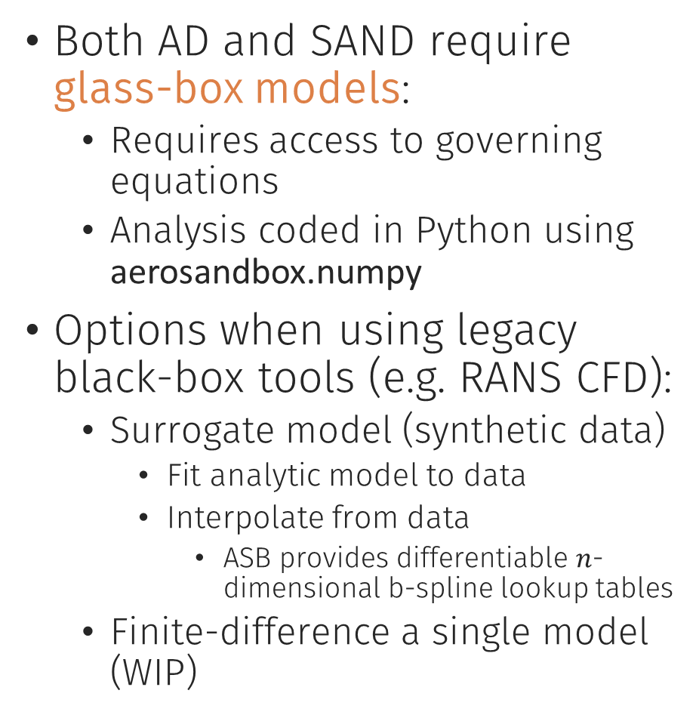
Caveat: Glass-Box Requirements
Both AD and SAND require glass-box models:
Requires access to governing equations
Analysis coded in Python using aerosandbox.numpy
Options when using legacy black-box tools (e.g. RANS CFD):
Surrogate model (synthetic data)
Fit analytic model to data
Interpolate from data
ASB provides differentiable $n$-dimensional b-spline lookup tables
Finite-difference a single model (WIP)
Drop-in differentiable replacement of NumPy/SciPy*:
N-dim array operations
Arithmetic, trig., log/exp
Conditionals, loops, logical operations
Linear algebra
(linear solves, pseudoinverses, norms, eigenvalues, factorizations)
Interpolation
Numerical differentiation/integration
Advanced: solvers for subproblems:
Rootfinders
QP and SOCP solvers
Adaptive-step integrators
etc.
# import numpy as np import aerosandbox.numpy as np
*Nearly complete

Slide 23
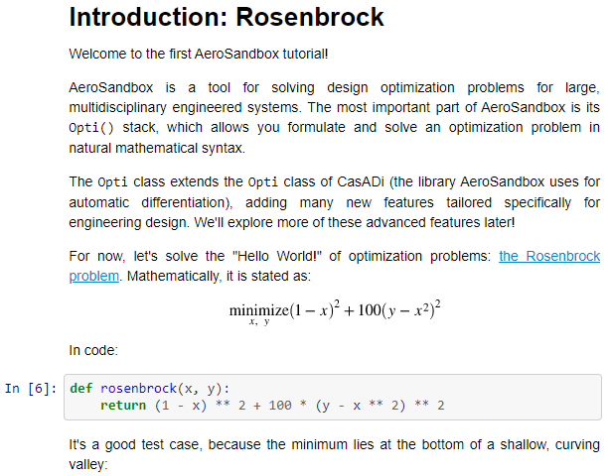
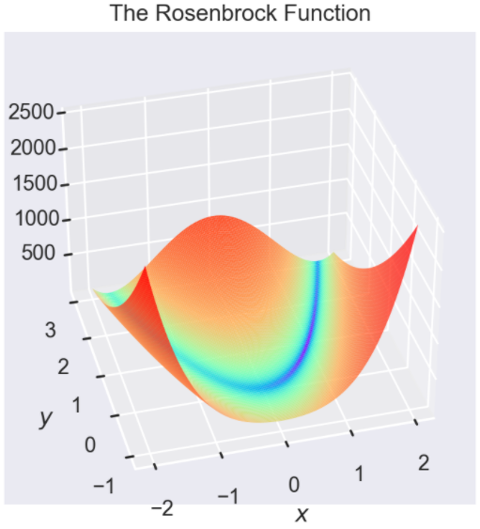
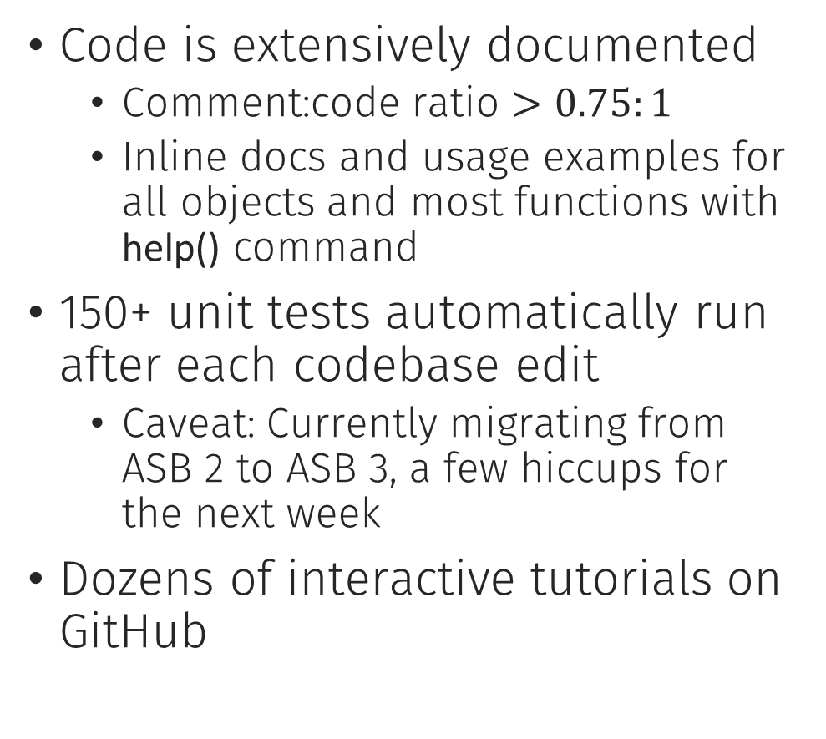
Documentation and Testing
Code is extensively documented
Comment:code ratio $>0.75:1$
Inline docs and usage examples for all objects and most functions with help() command
150+ unit tests automatically run after each codebase edit
Caveat: Currently migrating from ASB 2 to ASB 3, a few hiccups for the next week
Dozens of interactive tutorials on GitHub

Slide 24
AeroSandbox: Tools and Models
What else is in the box?

Slide 25
Tools and Models: Overview
Tools:
Geometry engine
Dynamics (time-dependence)
Surrogate modeling tools
Models:
Aerodynamics
Propulsion
Power systems
Atmosphere and winds
Structures and weights
…
Models are just a starting point
Not intended to be comprehensive
Designed to be easy to edit and extend

Slide 26

Tools: Dynamics
Capabilities
Solve ODEs, BVPs via direct collocation
Simulate dynamic systems
Fixed or variable time horizons
Multiphase dynamics (e.g. rocket boost and glide)
Optimal control
Implement integrators in one line:
Forward/backwards Euler
Midpoint method (2nd-order)
Runge-Kutta (in pre-release)
Shorthands for 2D aircraft dynamics
opti = asb.Opti() time = np.linspace(0, 1, 50) position = opti.variable( init_guess=np.linspace(0, 1, 50) ) velocity = opti.derivative_of( position, with_respect_to=time, method="runge-kutta" ) accel = opti.derivative_of( velocity, with_respect_to=time, method="midpoint" ) opti.subject_to([ force(time) == mass * accel, position[0] == 0, velocity[0] == 0, ]) sol = opti.solve()
Make an optimization problem
Create a time vector
Initialize position
Initialize velocity
Initialize acceleration
Governing eqn.: $F=ma$
Initial condition
Initial condition
Solve!
Notes:
All of these are just higher and higher level abstractions for the optimization engine:
You can implement your own integrators, or use the ones out of the box
Work at the level of abstraction that suits your needs

Slide 27
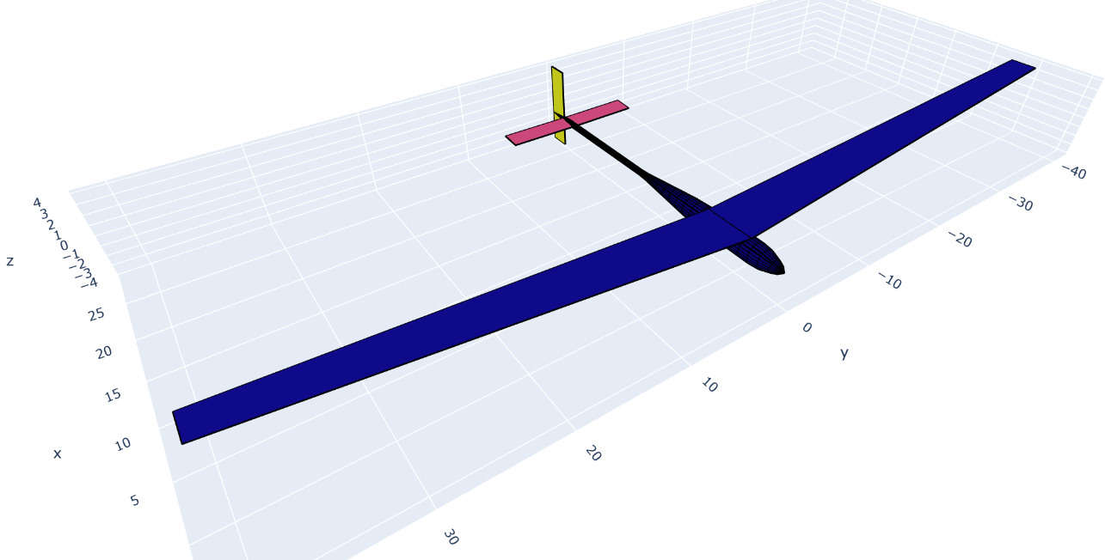
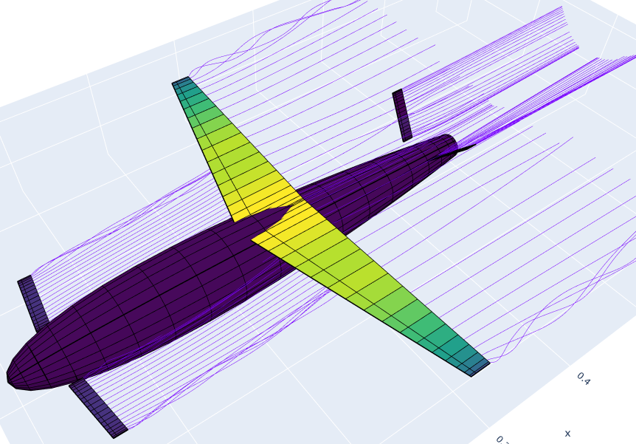
Tools: Geometry Stack
Object-oriented geometry stack:
Airplanes, wings, fuselages, airfoils, custom polygons/polyhedral
Lofting, parameter calculation (volume, wetted area, etc.)
Thin surface or solid
3D tri/quad surface meshing and visualization
File interfaces (*.dat, *.stl, *.avl, …)
Differentiable – supplies derivatives to analysis tools

Slide 28
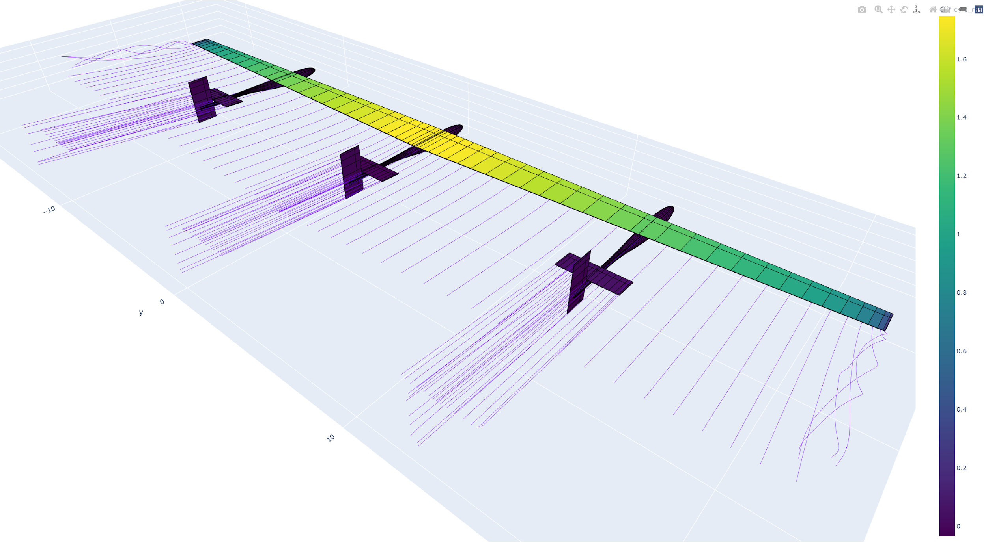
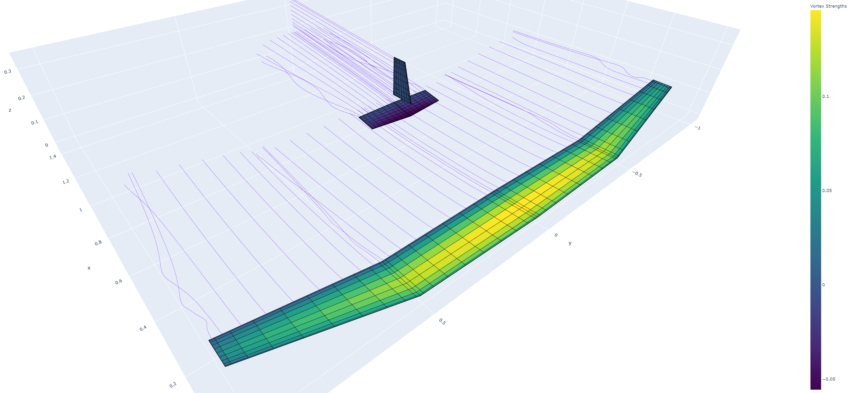
Models: 3D Aerodynamics
Options:
Semi-empirical buildup
Similar to DATCOM
Fully nonlinear lifting-line method:
Coupled viscous effects
Local stall
Modern modifications:
Nonzero sweep or dihedral
Multiple surfaces, fuselages
Vortex-lattice model
Dynamic problems: aerodynamics implicitly solved at each point on trajectory
Notes:
Peter
As mentioned before, we’re optimizing on aircraft design as well as mission
Aerodynamics are really where these two meet most directly!
Ties together OML and dynamics
Really important to get right
3 options
Semi-empirical buildup
LL <slide>
VLM
It turns out all the models we built cross-validate exceptionally well, resulting in aircraft designs that are only ~2% different in wingspan
We generally use workbook approach for computational speed
Solve aero. simultaneously at each point on traj.

Slide 29
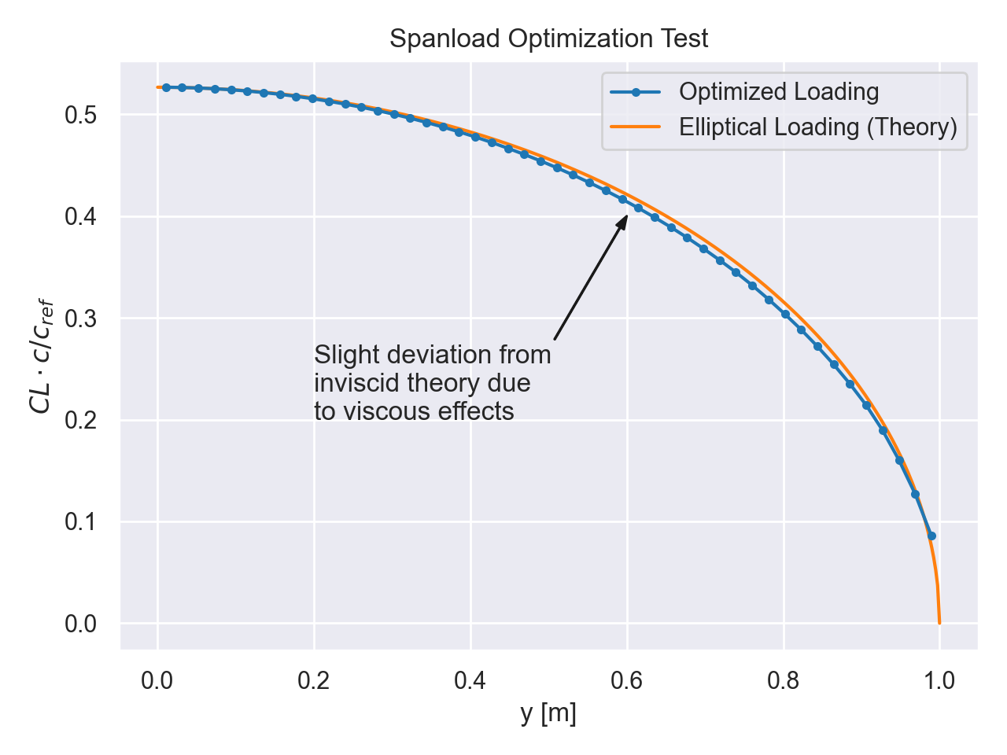
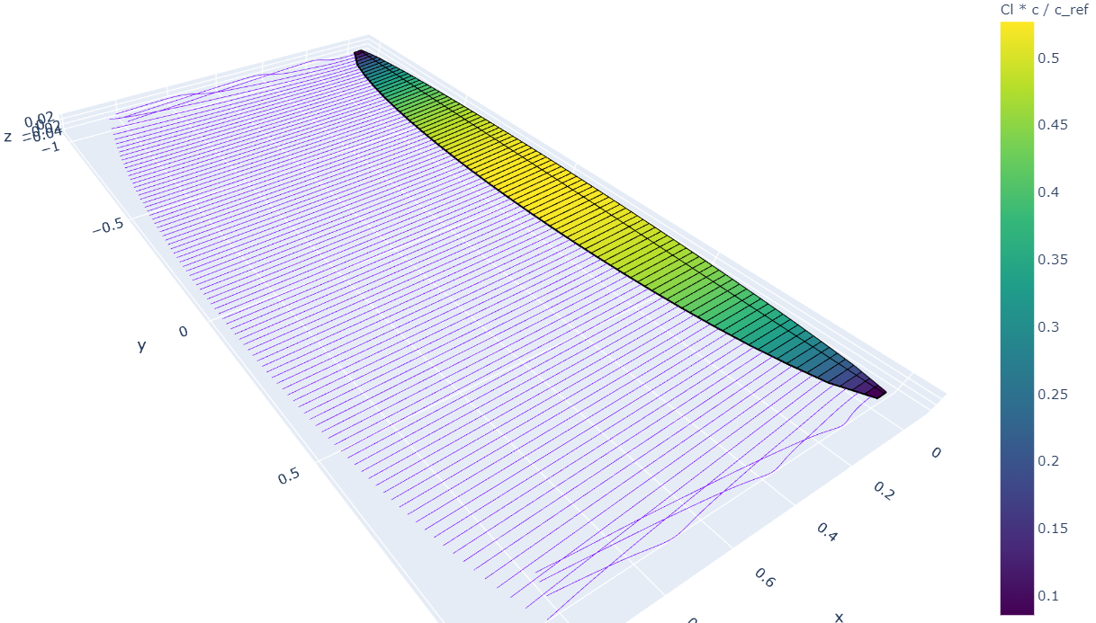
Models: 3D Aerodynamics
All three are end-to-end differentiable; optimizer-friendly
E.g.: Optimization of wing, with viscous effects
Notes:
Need to stress again: all models are differentiable
As we said before, that allows fast optimization
Example of spanload optimization
But also allows stability derivative calculation
Derivatives of derivatives

Slide 30
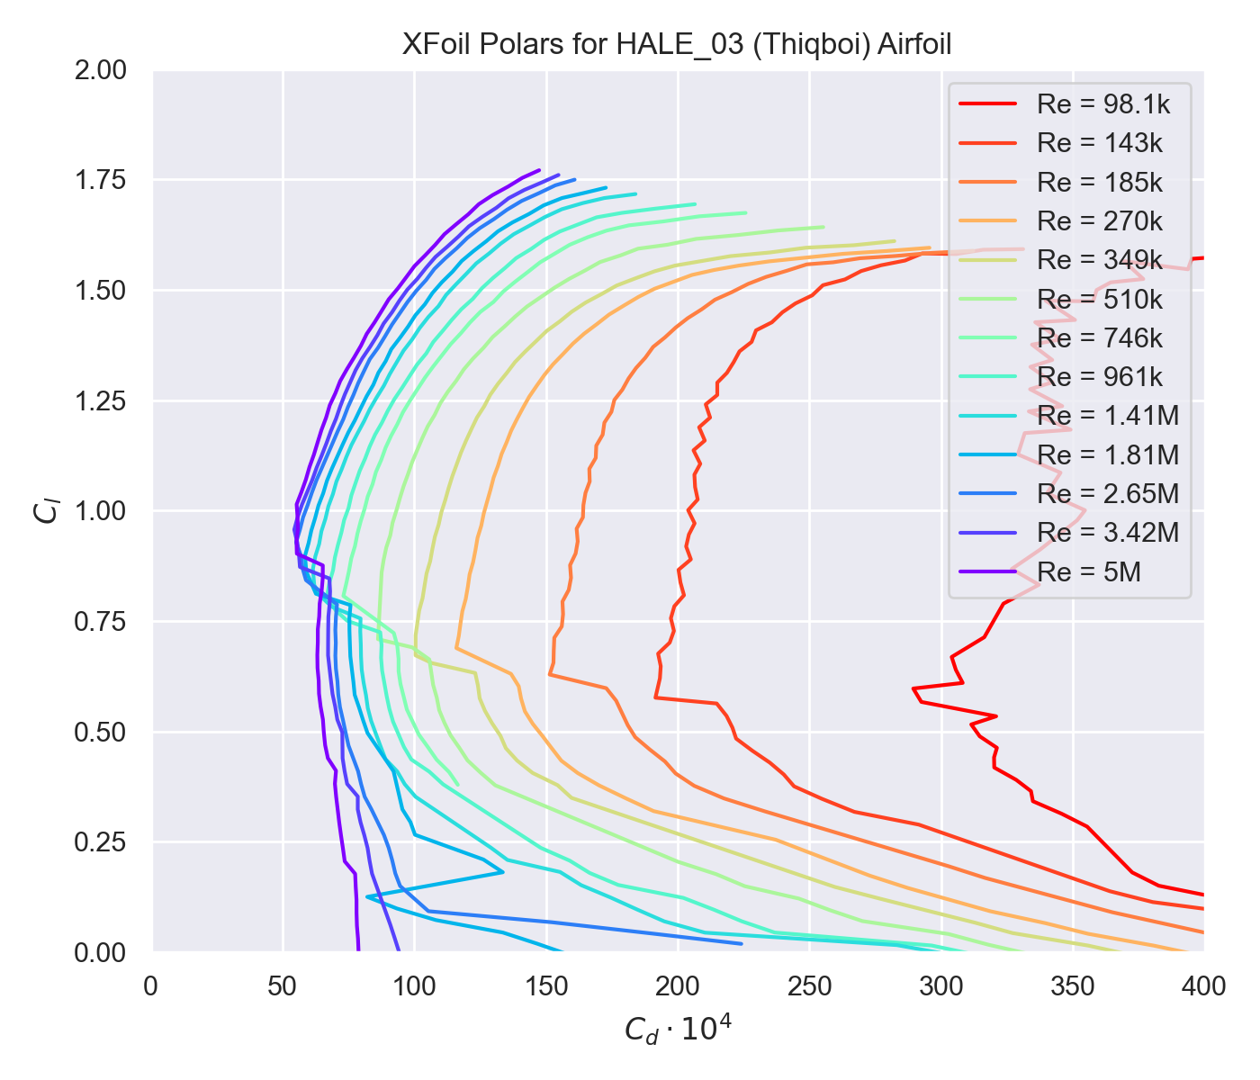
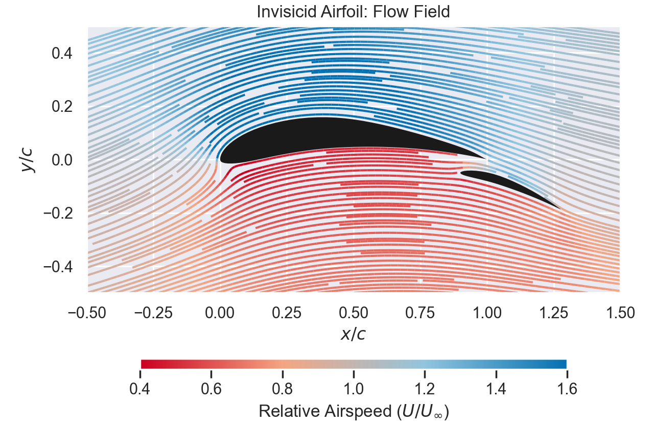
Models: 2D Aerodynamics
Options:
Interface to XFoil (not differentiable)
Useful for data retrieval, surrogate modeling
Uncoupled inviscid-viscous IBL model
Multielement, ground effect
Identical IBL implementation to XFoil
In progress: differentiable coupled IBL model (same as XFoil)
Will allow airfoil shape optimization coupled with vehicle design, trajectory

Slide 31
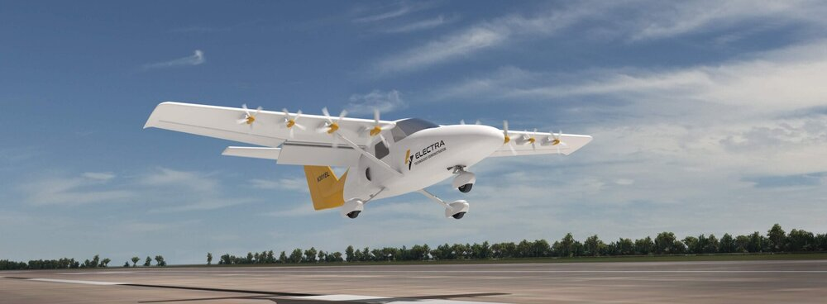

Models: Propulsion and Power Systems
Propulsion
Propeller
Disc-actuator model with viscous modifications
Differentiable blade-element model (same as QProp)
Rocket
Isentropic relations with empirical corrections for nozzle flow
Turbomachinery (WIP)
Power Systems
Solid rocket propellants
Burn rate suppressants (oxamide)
Batteries, solar cells
Avgas, Jet A (WIP)
Electra.aero UAM demonstrator: a development program using AeroSandbox for takeoff performance analysis
Firefly slow-burn-motor static fire at MIT: data used to calibrate AeroSandbox’s rocket performance library
Notes:
Every aerospace program needs their slice of the UAM pie, and AeroSandbox is no exception

Slide 32

Models: Structures & Weights
Structures
6-DoF Euler-Bernoulli beam model
Bending, torsion
Statistical models based on existing aircraft
Weights
Component-wise CG buildup
Moments of inertia
Stability derivatives easily computed via AD
Derivatives of stability derivatives
Stability options:
Static margin
Constrain stability derivatives
Constrain poles
Optimizing through an eigenvalue decomposition!
Main Wing Spar: Design & Loads

Slide 33


Models: Atmosphere and Winds
Atmosphere
Differentiable atmosphere enabling trajectory optimization
Wind speed modeling
Statistical model
By using probabilistic models, risk can be your objective function
Enables robust design

Slide 34
Application: Firefly
A Mach 0.8 rocket-propelled micro-UAV

Slide 35








Firefly: Requirements and Configuration
Requirements:
Mach 0.8 powered flight + glide
Size < 70 x 70 x 480 mm
Mass < 2 kg
Maximize total range
Drop
480 mm (19.0 in)
Unfold and stabilize
Powered flight
(~2 minutes)
70 mm (2.75 in)
Glide
(4-6 minutes)
Ignite rocket
Disposal
Discard stabilizer

Slide 36


Current baseline (v2) configuration
Folding tail & control surfaces
Rocket nozzle
Top payload
Smooth, near-Sears-Haack body reduces drag
Stabilizer
& laser igniter
Folding wing
100 mm
3D-printed titanium fuselage
Ablative insulation
Forward payload
Solid rocket propellant

Slide 37






Rocket propulsion for small fast aircraft: low-thrust, end-burn motor
Low thrust (< 10 N), long endurance (>120 s)
Long, end-burn motor
- Sides of propellant grain must not burn
Motor case contoured to low-drag fuselage shape (enabled by additive manufacturing)

Slide 38




Firefly: Range Optimization
Assumptions
Launch at 10 km, Mach 0.75
Maximizing total range
Simultaneously optimizing vehicle design and mission strategy
Results:
Range: 258 km
“Boost-glide” trajectory
Vehicle becomes a rocket-propelled glider
Very large lifting surfaces: 426 mm wingspan
High boost airspeed, but speed drops precipitously during glide ($L/D_{max}$)

Slide 39


Firefly: Understanding the Design Space
Observation: Glide speed is very low ($M≈0.1$) near end of flight
How would total range change if we enforced a minimum glide speed?
Initially, no change (loose constraint)
At $M≈0.12$, constraint becomes tight and starts reducing range
Glide performance almost zero for $M≥0.75$ case.
Vehicle exploits qualities favorable to boost performance

Slide 40

Firefly: Effect of Launch Altitude
Effect of varying launch altitude
15 kft launch: 218 km range
30 kft launch: 254 km range
50 kft launch: 291 km range
Sensitivity of range w.r.t. launch altitude: 6.8 meters/meter
Optimizer is directly manipulating control surface deflections to fly trajectory
Sensitivity of an optimal control problem

Slide 41

Firefly: Multi-objective Optimization and Pareto Efficiency
Tools to allow multi-objective optimization
E.g. trade-off between total range and boost range
Pareto frontier
Each point represents a unique airplane and trajectory
Shows where large gains can be found in one metric in exchange for minor setbacks in another
Missile-like design, more similar to old Firefly configuration
Glider-like design (baseline design point)
*Note: figure based on outdated assumptions, for illustration only

Slide 42
Application: Solar Airplane (“Dawn”)
A stratospheric airplane supporting atmospheric science research

Slide 43


Dawn: Requirements and Configuration
Requirements:
Unmanned platform
Payload:
30 kg
Power: 500 W day, 150 W night
Mission:
6 weeks continuous flight
July – Aug., continental U.S. (CONUS)
60,000 ft. (18.3 km) minimum altitude
Ability to relocate on command, stationkeep against winds
Survive gusts during ascent and thunderstorm overflight

Slide 44

Dawn: Mass Budgets
Component-wise mass buildup
Visualization tools to increase interpretability
By default, entire airplane and trajectory designed simultaneously
Selective freezing of design variables as subsystems become more “locked in”
Per-variable or by user-specified categories
Enables off-design performance analysis

Slide 45


Dawn: Carpet Plots and Envelope Exploration
Optimization speed enables sweep studies on mission parameters
Plots are the result of 3000 optimization runs, each with ~4000 variables (~30 min. total runtime on laptop, serial)
Fixed assumptions, rubber airplane
Rubber assumptions, fixed airplane
Notes:
Multidimensional sweeps of the design space
1000 runs is not 1000x the time; in fact, it’s far less
ASB exploits the fact that one run is a good initial guess for the subsequent one

Slide 46

Dawn: Cruise Dynamics
Diurnal power injection leads to unsteady optimal trajectories
Altitude cycling
Airspeed cycling
Initialized to steady flight
AeroSandbox finds unintuitive optimal control solutions
Simultaneously designing airplane and trajectory
Solar-Electric Airplane Trajectory, 99th-Percentile Winds
26000
25000
24000
23000
22000
21000
20000
19000
Day 1, solar noon
Day 2, solar noon
Headway requirement
Dusk
Ambient wind field
Dawn
Altitude-constrained
Notes:
Make sure to explain why you don’t have to consider ascent in the desgin
Where does strategy come from?
Be explicit on the wind field that potentially motivates this
Graphics
Move to KM

Slide 47

Dawn: Ascent Dynamics
Goal:
Find minimum-energy ascent profile
Find optimal takeoff time relative to solar noon
Precise timing required
Gust, cloud cover constraints
Results:
Optimal takeoff at ~11 p.m., relative to solar noon
Steep initial ascent followed by shallow entrance to diurnal cycle

Slide 48

Design Sensitivities
Figure of Merit | Sensitivities of Minimum Achievable Wingspan
Any added mass | 0.303 m/kg
Any added power draw* | 0.0172 m/W
Any added drag | 0.705 m/N
Battery spec. energy | -0.110 m/(Wh/kg)
Battery packing fraction** | -0.546 m/(%)
Solar cell efficiency** | -0.984 m/(%)
Solar cell area density | 18.4 m/(kg/m^2)
Propeller COP** | -0.819 m/(%)
Motor Efficiency** | -0.773 m/(%)
Nighttime Altitude Req. | 4.13 m/km
$$\frac{∂(\text{wingspan})}{∂(\text{variable})}$$
Design sensitivities obtained “for free”
Inform subsystem-level decisions, e.g.:
Motor efficiency vs. motor mass
Marginal benefit of dollars spent on advanced technologies
Identifying active and inactive constraints in requirements
What’s limiting the design?
* Assumed constant over 24 hours
** Derivatives w.r.t. percentages are in terms of absolute percentage points (i.e. 25% → 26%), not multiplied percentages

Slide 49
Final Notes: Optimization Caveats
Engineering time is often (implicitly) part of your objective function
80% of the results come from 20% of the work – low-fidelity models go exceptionally far
Identify sensitive models and assumptions, then focus on refining those
Do not blindly trust an optimizer
An optimizer only solves the problem you give it
Often, we forget constraints that seem “intuitive”
If any flaw exists in your model, an optimizer will exploit it – garbage in, garbage out
Without adding margin, optimized designs are almost always fragile
An optimizer will often naturally drive to the edge of the feasible space
In nature, optima are usually not near extremes
Make sure your optimized designs pass the TLAR (“That looks about right”)
90% of design is asking the right question
Notes:
Engineering time is part of your objective function
Low-fidelity models go far
Capture simple physics: focus on breadth, not depth of modeling
Do not blindly trust an optimizer
We forget constraints that seem intuitive
Example
A design study this summer required us to constrain the wingspan below an amount that the optimizer was “happy” with
Optimizer changed to a canard design, shrunk the “wing” and made the “horizontal stabilizer” the primary lifting surface
In nature, optima are usually not near extremes
Goes back to what Mark was saying about how your mass fractions should be roughly comparable

Slide 50
Final Notes: Key Take-Aways
AeroSandbox is a differentiable framework for engineering design optimization
Includes lots of useful aerospace models, but the real paradigm shift is the optimization framework
AD and SAND improve optimization speed by orders of magnitude
Fast enough to support:
Interactive design
Real-time design discussions between subteams
Complex design and optimal control problems
Numerics abstracted; designed to “just work”
Tested in numerous ongoing aircraft development programs

Slide 51
Thank you and happy optimizing!
https://github.com/peterdsharpe/AeroSandbox

Slide 52
Backup

Slide 53

Backup: Sparsity

Slide 54

Backup: Wind Gusts

Slide 55


Backup: Firefly, Minimum-Mach Trajectory

Slide 56

Backup: SAND XDSM
XDSM of MDO Architecture:
Optimizer and Disciplines
Data flows clockwise, just like a matrix: Ax = b
Same sparsity as Jacobian of constraints (residuals)
Notes:
This is the optimization in one picture.
XDSM, for all the aircraft design folks in the audience:
XDSM (Extended Design Structure Matrix) is a common MDO visualization technique
Data flows clockwise - essentially just like data flow in a square matrix
In Ax = b, A is a mapping from x to b, and it represents some data flow - that’s exactly what this is
LinAlg connections go further
This chart has the same sparsity pattern as the problem: you can think about the methods you would solve a nonlinear system of equations with this sparsity pattern in the Jacobian - it’s almost exactly the same thing
These disciplines are key drivers. We’ll discuss each of these at a high level on the following slides, “A good outline for the next few slides”

Slide 57

Backup: A Comparison of Gradient Methods
Method
 | Finite Difference | Symbolic Differentiation* | Analytical Derivatives* | Automatic Differentiation*
Description | Pick two points, draw a line: $$\frac{df}{dx}=\frac{f\left(x+h\right)−f(x)}{h}$$ | Use a symbolic engine to compute an expression for the derivative (Wolfram-Alpha, Mathematica) | Hand-compute the adjoints and write separate code to compute derivatives from this. | Create a computational graph, then chain-rule backwards through it.
Computational complexity in $n$ dimensions | $$𝒪(n)$$ | $𝒪(≫n^{3})$, probably non-polynomial | Potentially $𝒪(1)$, though can require a huge amount of work by hand | $$𝒪(1)$$
Exact down to $≈$machine precision | No**, usually to $\sqrt{ε}$ | Yes | Yes | Yes
Other Pros | Black-box compatibility | Simplifies expressions where possible
Other Cons | Sensitive to small changes in $f(x)$ (e.g. adaptive-step ODE integration) | Memory usage Control flow (if/then, for loops, etc.) | In practice, requires an astronomical amount of development work | Generally requires operator overloading or code parsing
Figure of Merit
* Unfortunately, the names associated with different methods are not universally accepted by all fields – however, the names listed here reflect dominant trends.
** Complex-step finite differencing or higher-precision arithmetic can alleviate the accuracy issue, but these options are even slower and may not be as supported by numerical libraries.
Notes:
Consider dropping the last two rows

Slide 58




Backup: Convexity
Log-convexity
Many, but not all simple engineering models can be roughly approximated as log-convex
More complex models usually cannot
Convex and Nonconvex Functions
Definitions:
Formally:
For any two points on $f(x)$, the line segment that connects them never goes below $f(x)$.
Practically:
$f^{′′}(x)≥0$ everywhere (“curves up”)
Figure reproduced w/ permission from M. Vernacchia, “Modeling Compress. Aero. Of Aircraft in GPs” manuscript

